Slide 1
Field Study Methods
Interview/Observation | Participant | Naturalistic
Semi- or unstructured | Ethnographic Research
Semi-structured |  | Contextual Inquiry
Observations and interviews are the primary techniques in Field study.
Observations: The main difference between participant observation and naturalistic observation is that, in participant observation, the researcher (ethnographer) not only observes a social group, setting or subject matter, but engages in the participation actively with a general commitment to observing everyday social life. This is in contrast to observational methods, which look to make systematic observations about behavior in situ. Naturalistic observation involves observing involves studying the spontaneous behavior of participants in natural surroundings.
Interviews: There are three types of interviews, structured, semi-structured and un-structured interviews. Structured interview has a rigorous set of questions which does not allow one to divert, a semi-structured interview is open, allowing new ideas to be brought up during the interview as a result of what the interviewee says. The interviewer in a semi-structured interview generally has a framework of themes to be explored. Unstructured interviews do not use any set questions, instead, the interviewer asks open-ended questions based on a specific research topic, and will try to let the interview flow like a natural conversation.
Notes:
https://www.tandfonline.com/doi/pdf/10.3109/0142159X.2013.804977
https://www.simplypsychology.org/observation.html
https://www.nngroup.com/videos/3-types-user-interviews/
https://www.simplypsychology.org/interviews.html
https://www.usabilitybok.org/contextual-inquiry

Slide 2
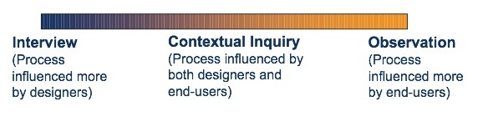
Contextual inquiry is a cross between interviews and observation and combines the strengths of both. In a contextual inquiry, the interviewer goes to the user and interviews them where they do their work.
The idea is to interview users in the context of their work, while they are performing their tasks, asking them questions about what they are doing and why (when necessary) along the way
Notes:
https://wiki.fluidproject.org/display/fluid/Contextual+Inquiry
https://player.slideplayer.com/39/10920530/#

Slide 3
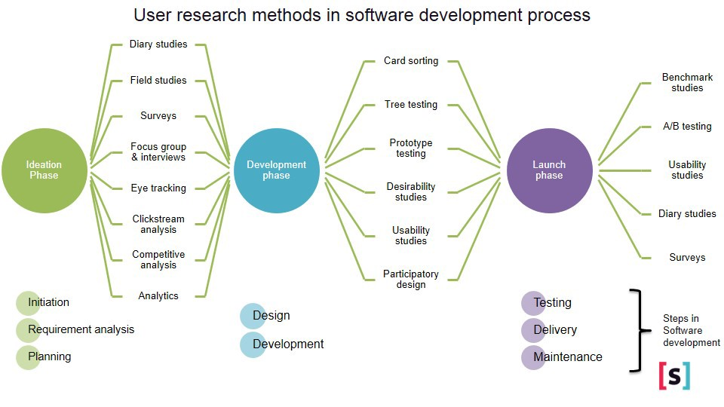
Notes:
https://medium.com/happyfresh-fleet-tracker/case-study-happyfresh-map-ux-research-dbae5132ed6a

Slide 4
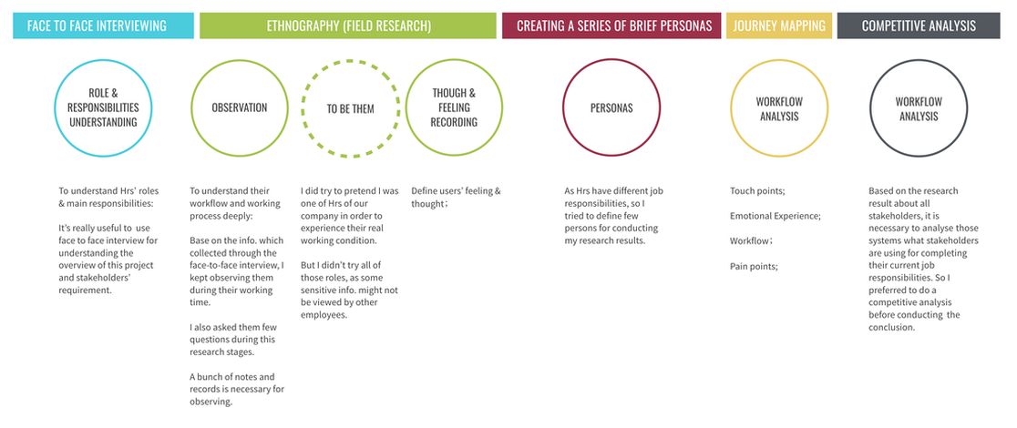
Notes:
https://www.ellenxjiang.com/user-experience-research.html

Slide 5
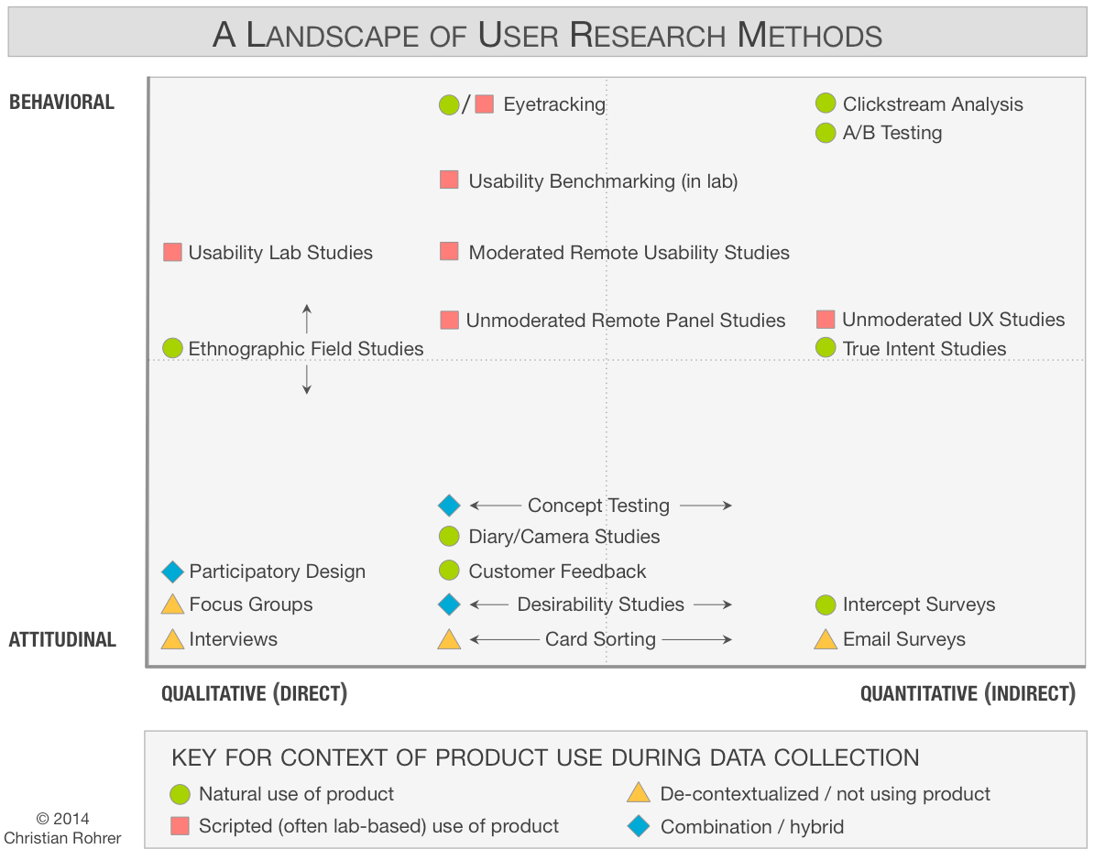
Notes:
https://www.nngroup.com/articles/which-ux-research-methods/
https://www.nngroup.com/courses/research-beyond-user-testing/

Slide 6
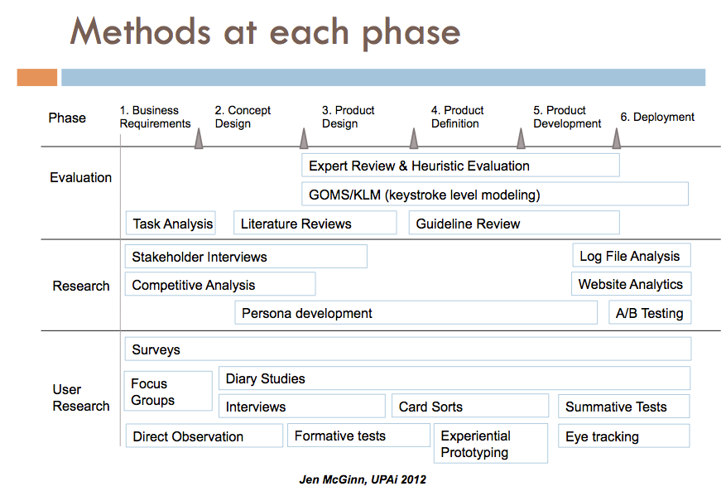
Notes:
https://blogs.oracle.com/jen/when-to-use-each-user-research-method

Slide 7
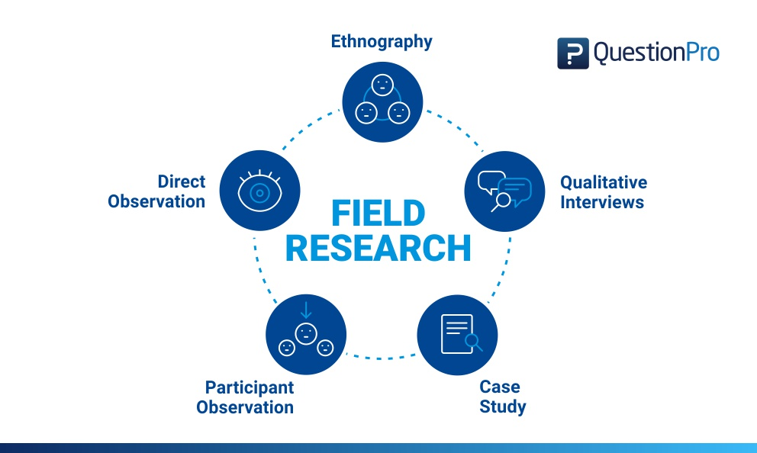
Notes:
https://www.questionpro.com/blog/field-research/

Slide 8
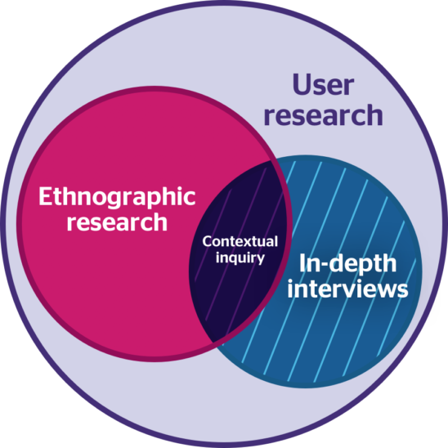
Notes:
https://fuzzymath.com/blog/ethnographic-research-design/

Slide 9
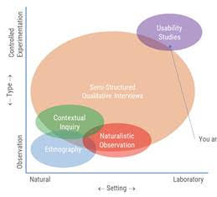
Notes:
https://fuzzymath.com/blog/ethnographic-research-design/

